Slide 1

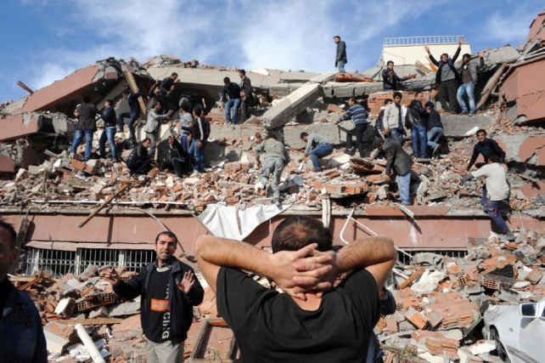
Building Bridges
… between all (or many?) participants in
crisis communication and disaster relief
Christoph Dennenmoser
HumanityRoad - Team Leader Urgent Needs
German Red Cross – Disaster Manager
Twitter: @sahnetaeter

Slide 2

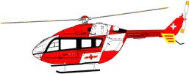
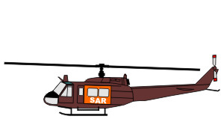
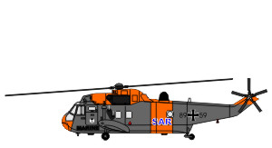
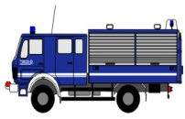
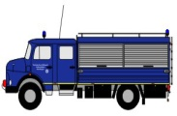
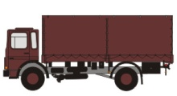
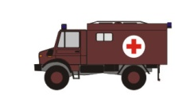
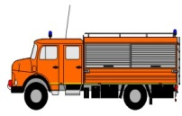
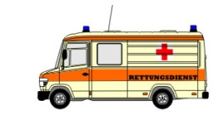
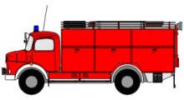
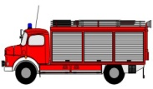
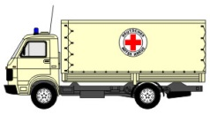
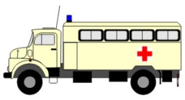
Disaster Management
National
Regional
Local
County
Governmental
Committees
Operational
Forces

Slide 3

A Matter of Opinion
„They don‘t know about my job!“
„They don‘t do a good job anyway!“
„They are only keen on publicity!“
„Their activities don‘t relate to my tasks!“
„There is no way like my way!“

Slide 4



A Matter of Opinion
„They don‘t know about my job!“
„They don‘t do a good job anyway!“
„They are only keen on publicity!“
„Their activities don‘t relate to my tasks!“
„There is no way like my way!“

Slide 5

Stop Playing!
=
Start
/ Continue
collaboration
sharing information
appreciation
It’s a Matter of Life and Death !

